Slide 1
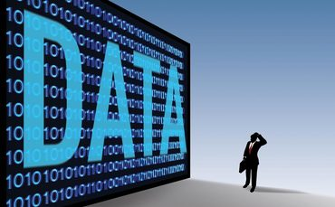
Theme of this Course
Large-Scale Data Management
Big Data Analytics
Data Science and Analytics
How to manage very large amounts of data and extract value and knowledge from them

Slide 2
Introduction to Big Data
What is Big Data?
What makes data, “Big” Data?

Slide 3
Big Data Definition
No single standard definition…
“Big Data” is data whose scale, diversity, and complexity require new architecture, techniques, algorithms, and analytics to manage it and extract value and hidden knowledge from it…

Slide 4
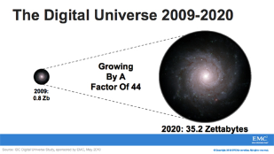
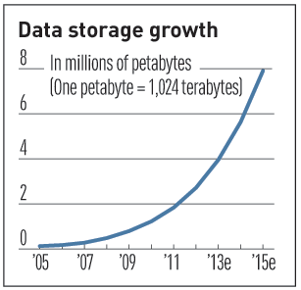

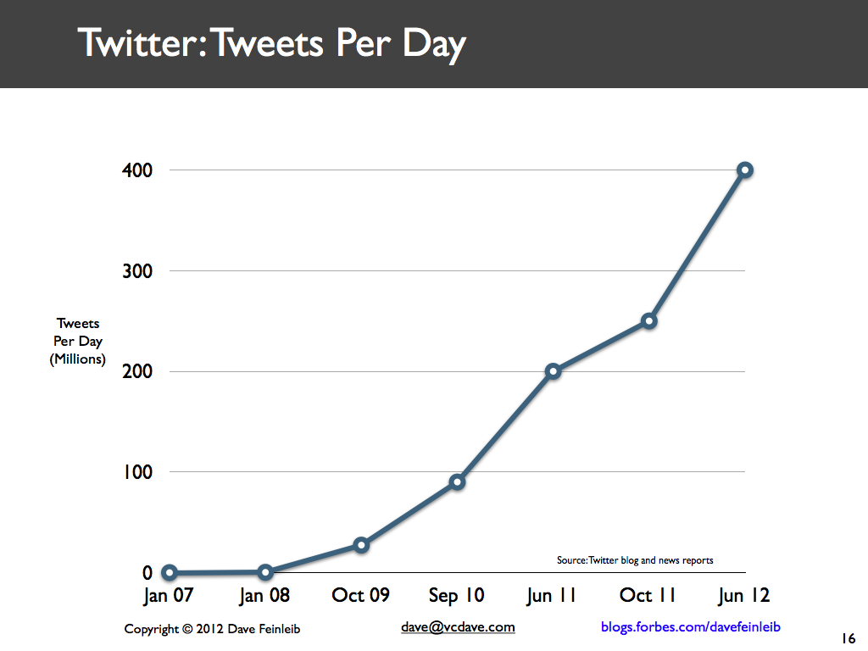
Characteristics of Big Data: 1-Scale (Volume)
Data Volume
44x increase from 2009 to 2020
From 0.8 zettabytes to 35zb
Data volume is increasing exponentially
Exponential increase in collected/generated data

Slide 5
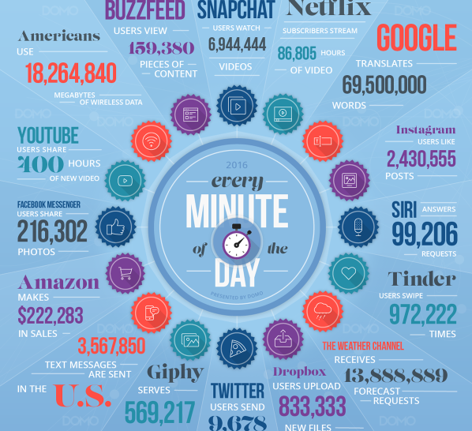

Slide 6
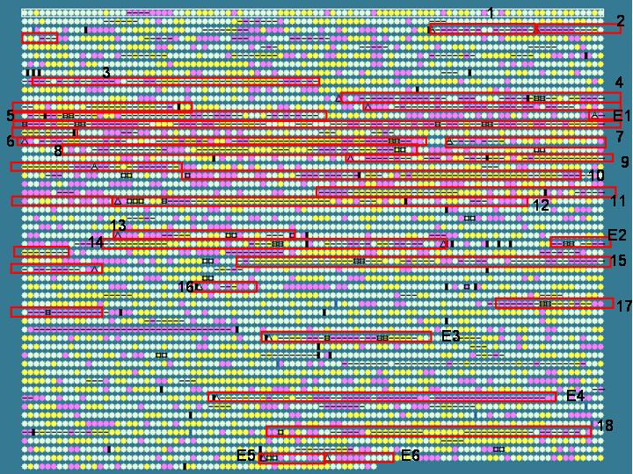
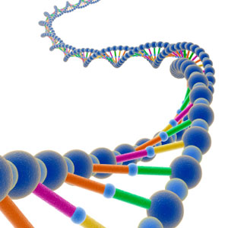
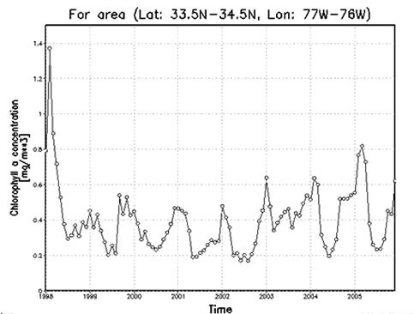

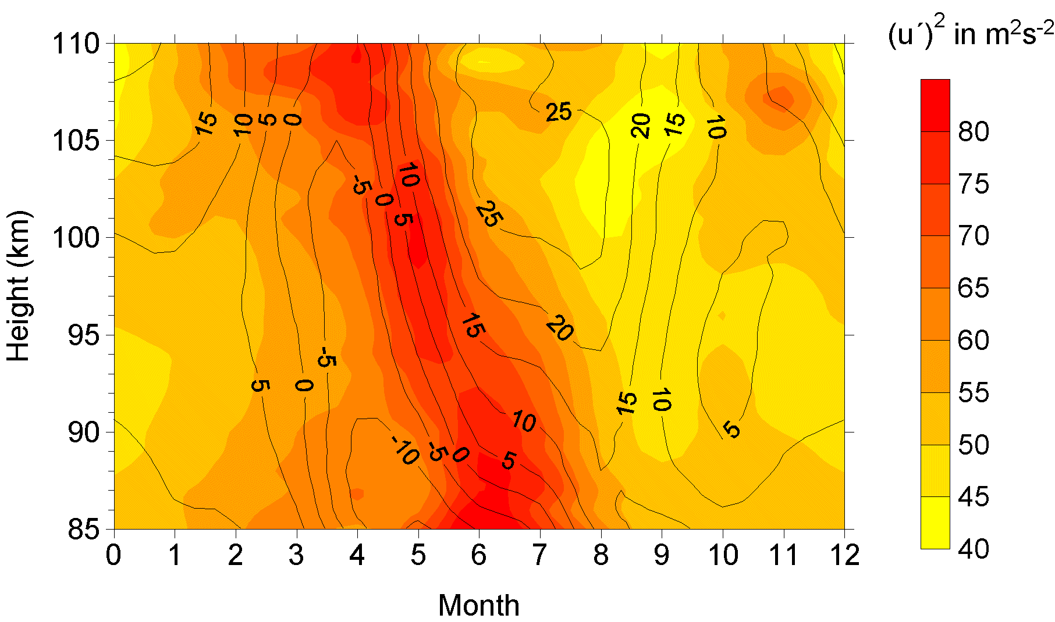
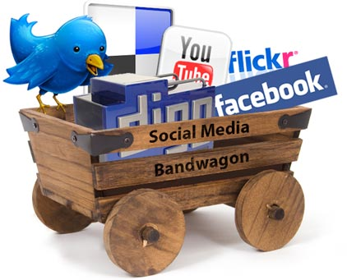
Characteristics of Big Data: 2-Complexity (Varity)
Various formats, types, and structures
Text, numerical, images, audio, video, sequences, time series, social media data, multi-dim arrays, etc…
Static data vs. streaming data
A single application can be generating/collecting many types of data
To extract knowledge➔ all these types of data need to linked together

Slide 7

Characteristics of Big Data: 3-Speed (Velocity)
Data is begin generated fast and need to be processed fast
Online Data Analytics
Late decisions ➔ missing opportunities
Examples
E-Promotions: Based on your current location, your purchase history, what you like ➔ send promotions right now for store next to you
Healthcare monitoring: sensors monitoring your activities and body ➔ any abnormal measurements require immediate reaction

Slide 8
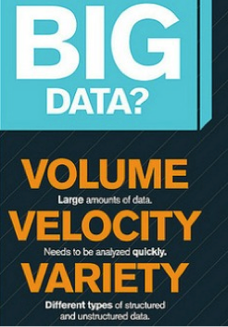

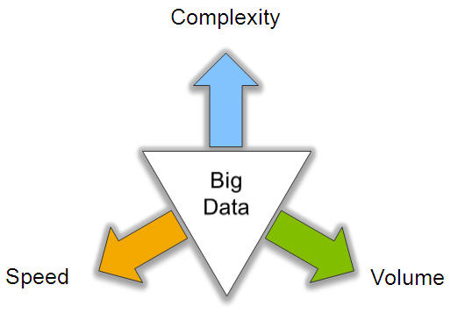
Big Data: 3V’s

Slide 9
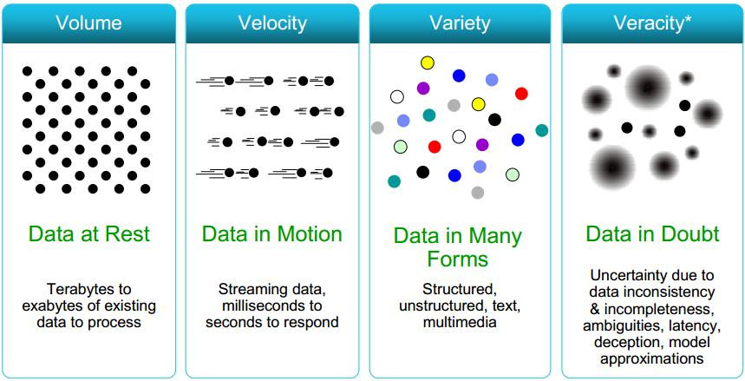
Some Make it 4V’s

Slide 10
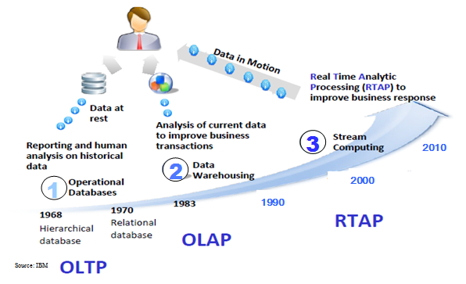
Harnessing Big Data
OLTP: Online Transaction Processing (DBMSs)
OLAP: Online Analytical Processing (Data Warehousing)
RTAP: Real-Time Analytics Processing (Big Data Architecture & technology)

Slide 11
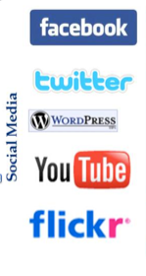
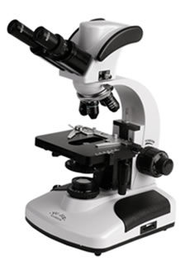

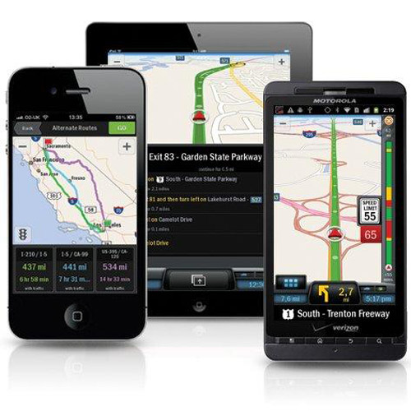
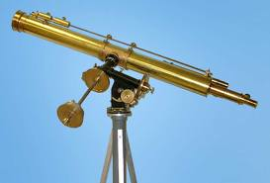
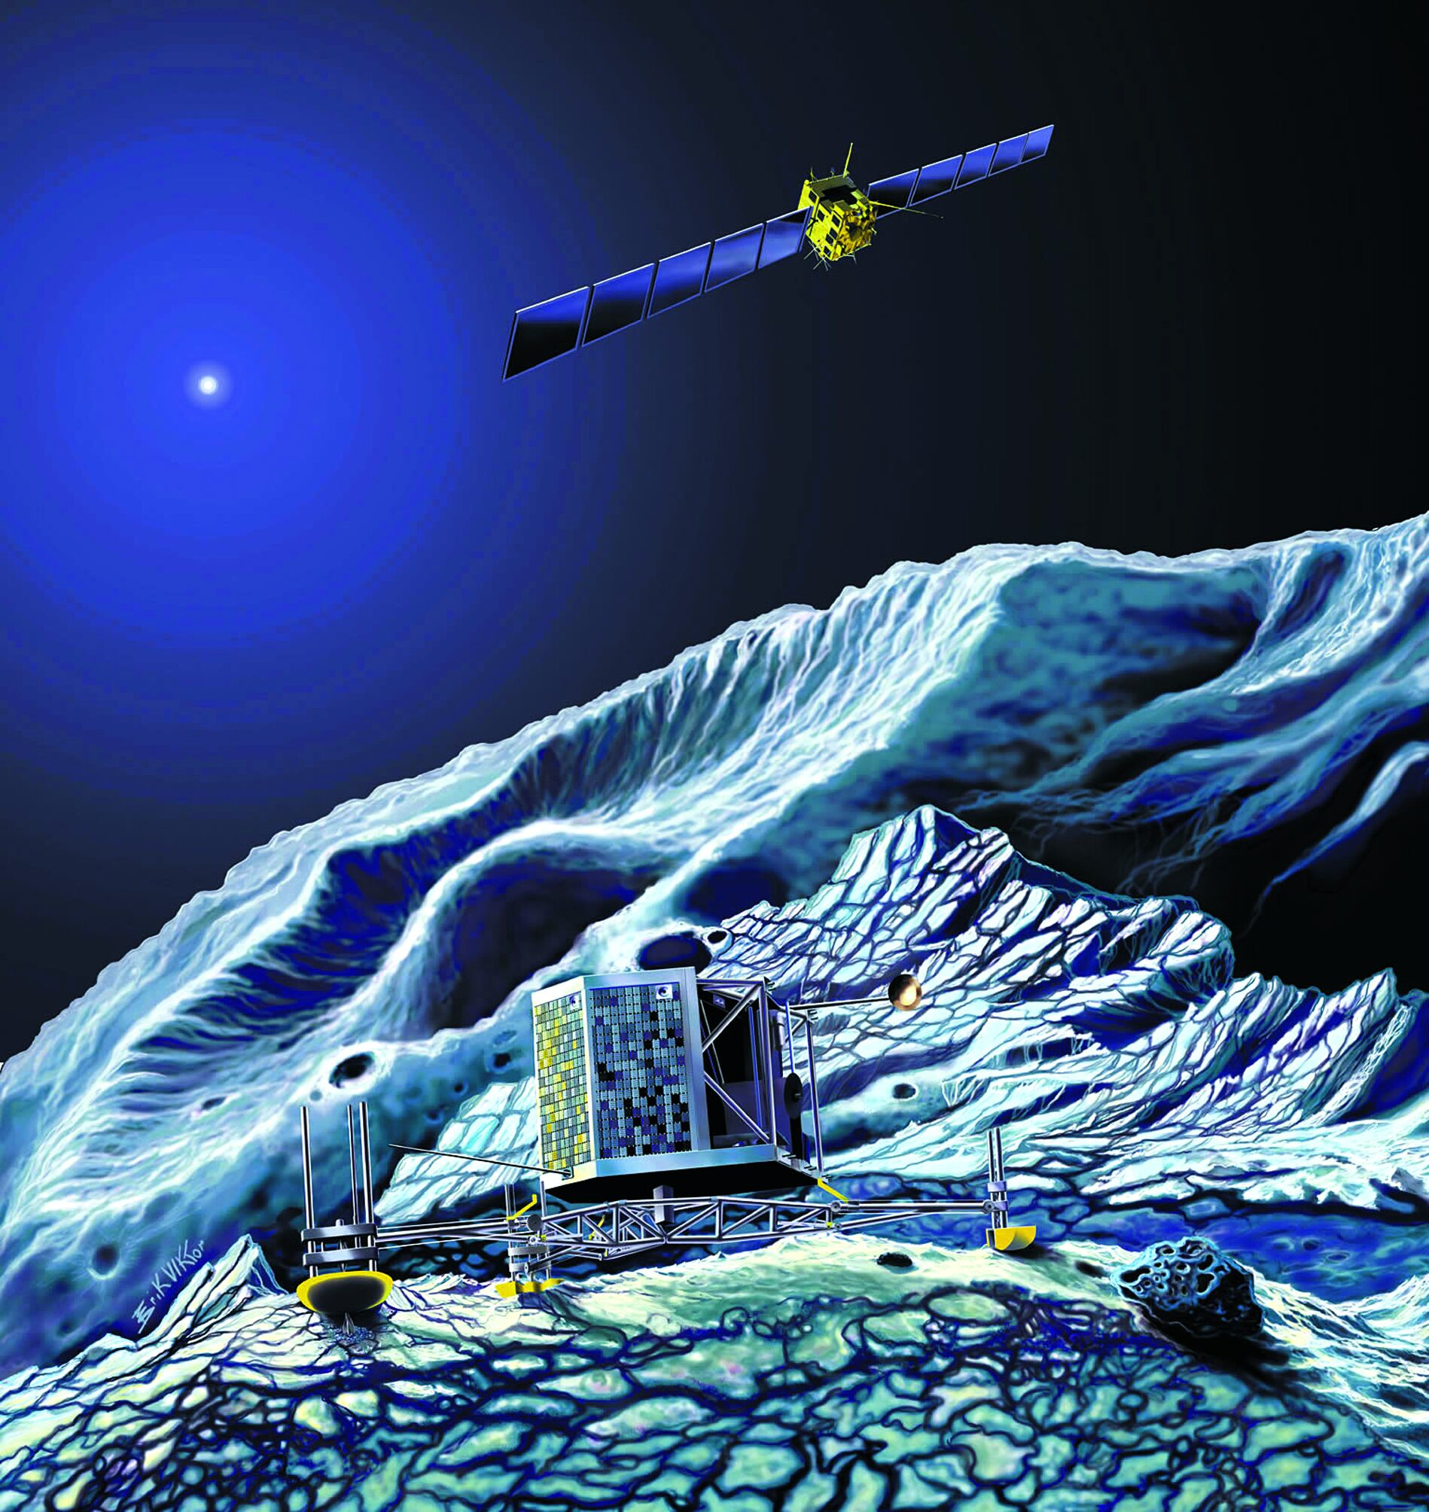
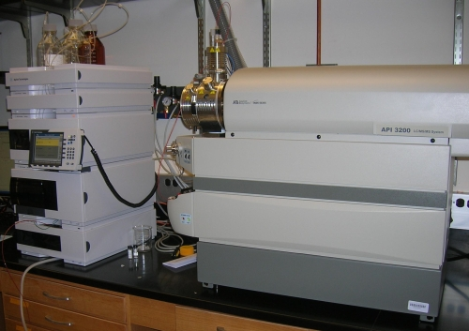
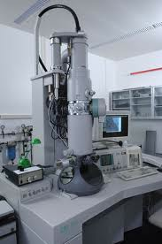
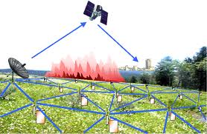
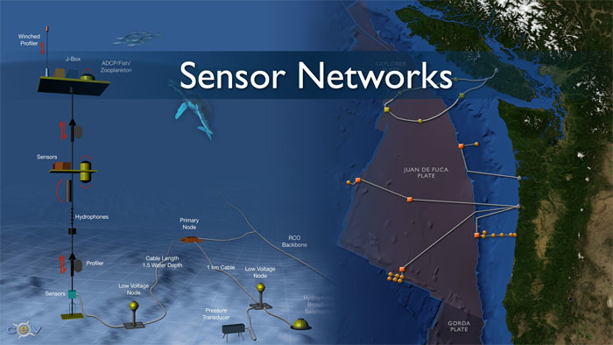
Who’s Generating Big Data
Mobile devices
(tracking all objects all the time)
Social media and networks
(all of us are generating data)
Scientific instruments
(collecting all sorts of data)
Sensor technology and networks
(measuring all kinds of data)
The progress and innovation is no longer hindered by the ability to collect data
But, by the ability to manage, analyze, summarize, visualize, and discover knowledge from the collected data in a timely manner and in a scalable fashion

Slide 12
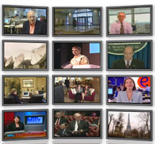

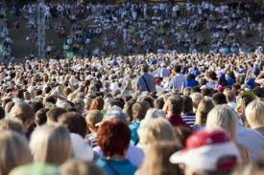

The Model Has Changed…
The Model of Generating/Consuming Data has Changed
Old Model: Few companies are generating data, all others are consuming data
New Model: all of us are generating data, and all of us are consuming data

Slide 13
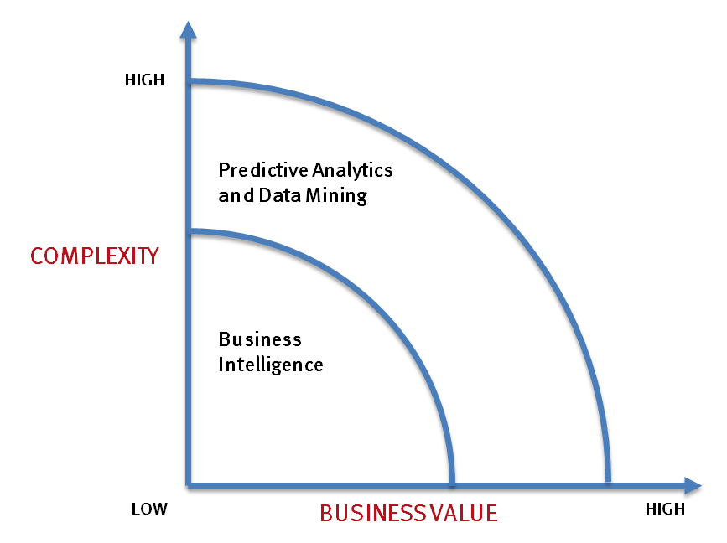
What’s driving Big Data
- Optimizations and predictive analytics
- Complex statistical analysis
- All types of data, and many sources
- Very large datasets
- More of a real-time
- Ad-hoc querying and reporting
- Data mining techniques
- Structured data, typical sources
- Small to mid-size datasets

Slide 14
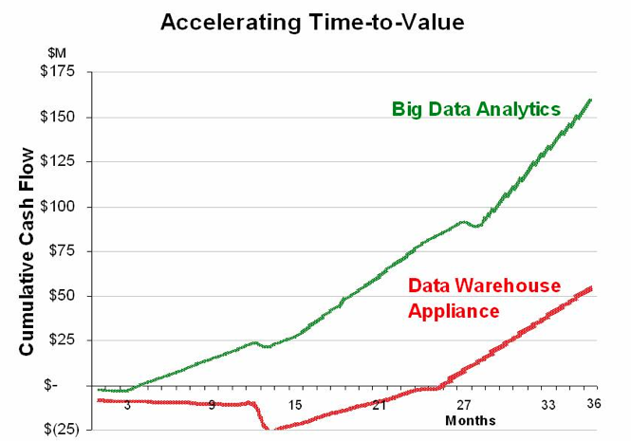
Value of Big Data Analytics
Big data is more real-time in nature than traditional DW applications
Traditional DW architectures (e.g. Exadata, Teradata) are not well-suited for big data apps
Shared nothing, massively parallel processing, scale out architectures are well-suited for big data apps

Slide 15
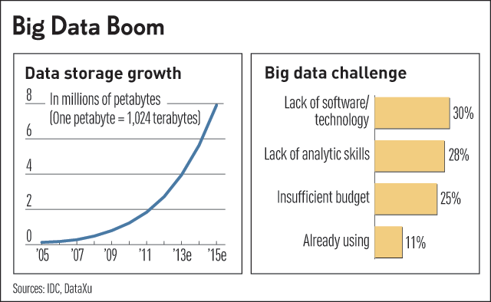
Challenges in Handling Big Data
The Bottleneck is in technology
New architecture, algorithms, techniques are needed
Also in technical skills
Experts in using the new technology and dealing with big data

Slide 16
What Technology Do We Have
For Big Data ??

Slide 17
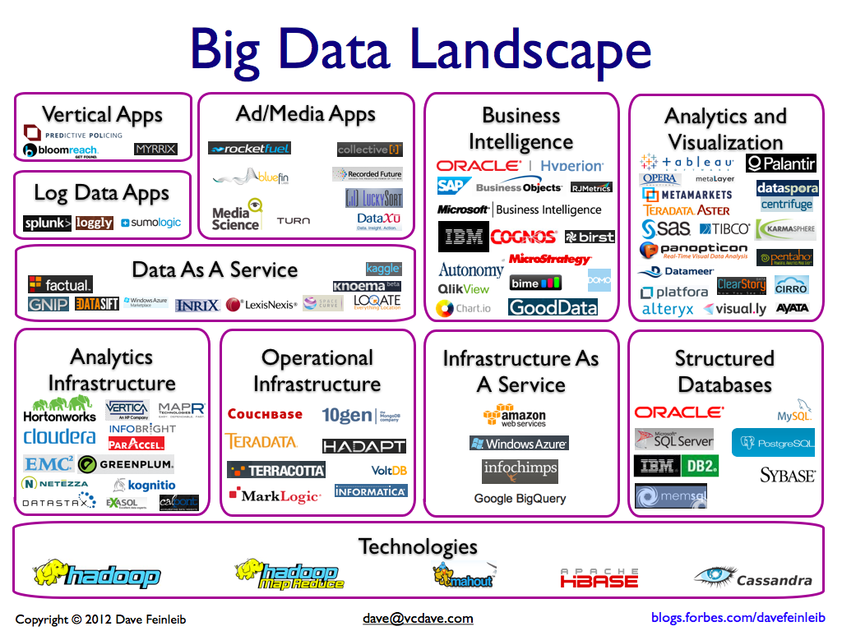

Slide 18
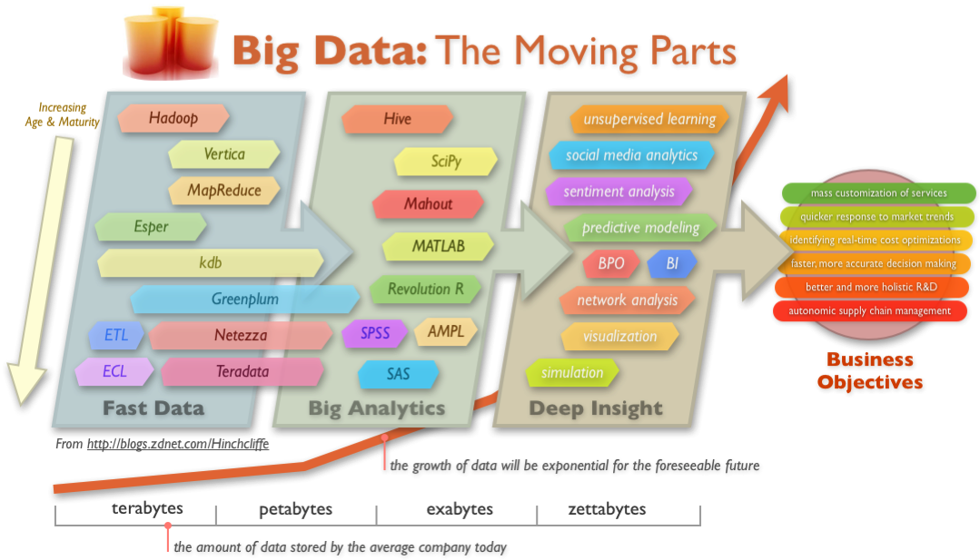
Big Data Technology

